Slide 1

Light Boxes

Slide 2


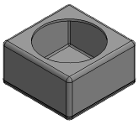
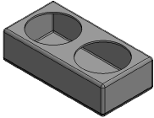
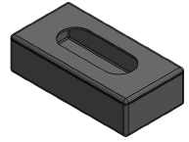
Product Overview
  Light Boxes are a rotational molded sealed box. Minimizer will have three available box options, both single and oval light boxes will be available. Ideal for OEM’s looking to incorporate a composite light box for reduced manufacturing costs or end users looking to add an optional preformed light-box. Lightweight, durable and non-corrosive. Boxes can be mounted to a wide array of truck / box / and trailer applications.
Details / Specifications
  5.68” (L) x 5.68” (H) x 3.10” (D) Single Round – Fig. A
  11.18” (L) x 5.68” (H) x 3.10” (D) Double Round – Fig. B
  11.18” (L) x 5.68” (H) x 3.10” (D) Oval Light – Fig. C
  Features
  Rotational Molded – no pieced seams.
  Made from polyethylene
  Life Time Warranty
  Does not include any drilled holes, only light hole cutouts
  Requires a light grommet or mounting flange for installation of lights.
Fig. A
Fig. B
Fig. C

Slide 3
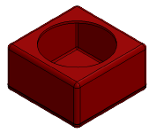
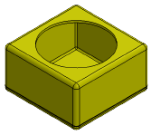
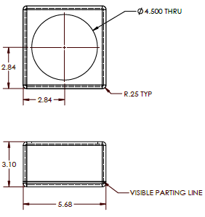
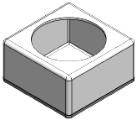
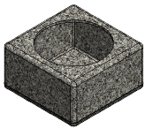
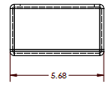
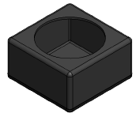
Single Round Light Boxes
  101015 PE Red
  101016 PE Silver
  101017 PE Yellow
  101018 PE White
  101019 PE Granite Grey
  101020 PE Black
  Overall Dimensions: 5.68” (L) x 5.68” (H) x 3.10” (D)
  Wt.: .55 lb.
  Process: Rotational Molding
  Material: Polyethylene
  Life-Time Warranty
  Sold Individually

Slide 5
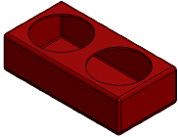
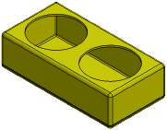
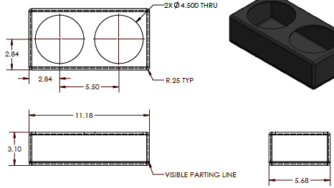
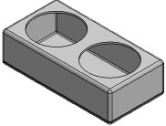
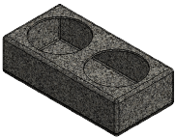
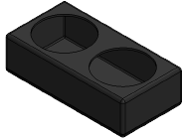
Double Round Light Boxes
  101009 PE Red
  101010 PE Silver
  101011 PE Yellow
  101012 PE White
  101013 PE Granite Grey
  101014 PE Black
  Overall Dimensions: 11.18” (L) x 5.68” (H) x 3.10” (D)
  Wt.: .90 lb.
  Process: Rotational Molding
  Material: Polyethylene

Slide 6
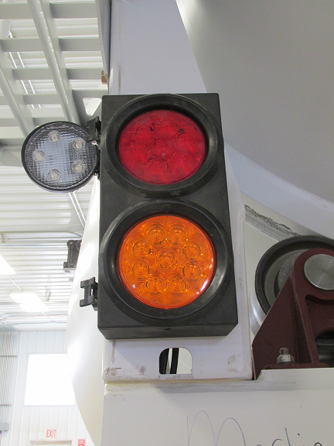
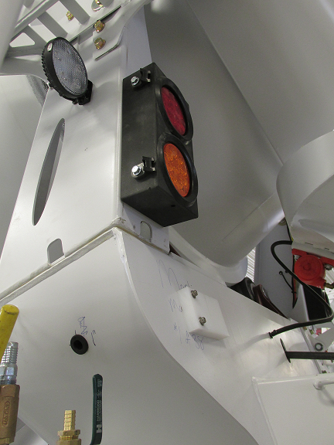

Slide 8
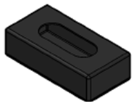
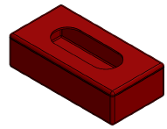
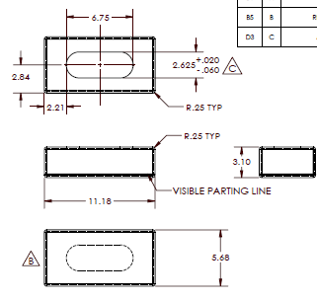
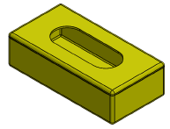
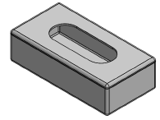
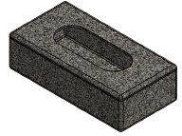
Oval Light Boxes
  100476 PE Black
  101036 PE Red
  101037 PE Silver
  101038 PE Yellow
  101039 PE White
  101040 PE Granite Grey
  Overall Dimensions: 11.18” (L) x 5.68” (H) x 3.10” (D)
  Wt.: 1 lb.
  Process: Rotational Molding
  Material: Polyethylene

Slide 9
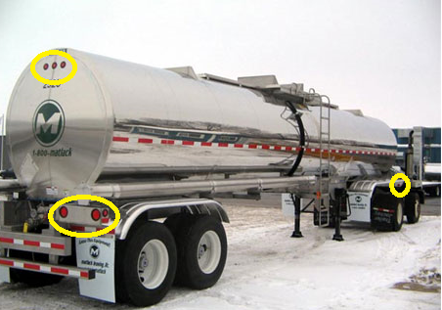
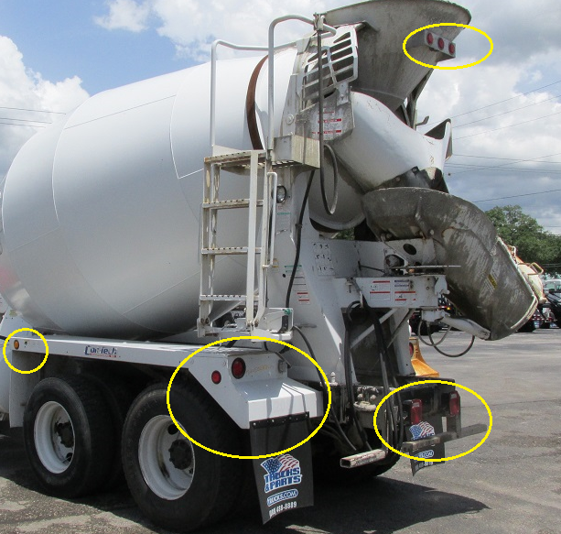
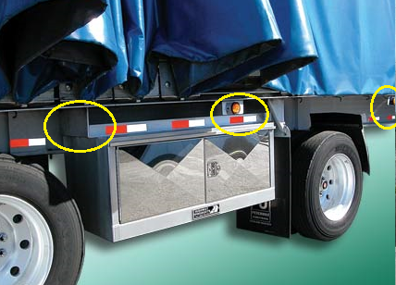
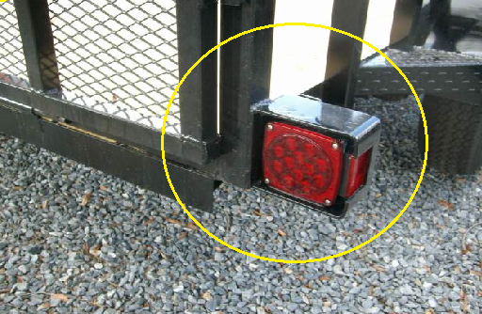

Slide 10
