Slide 1
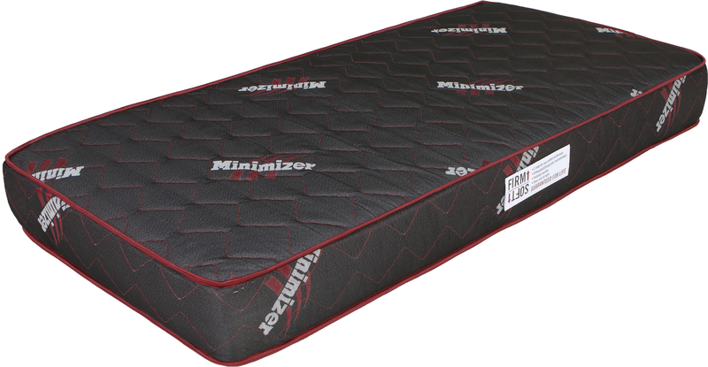


Slide 2

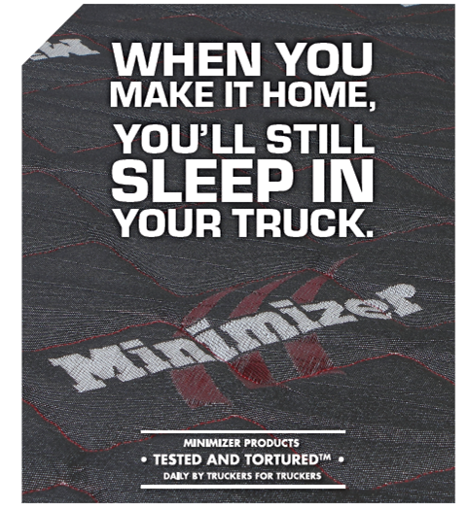

Slide 3

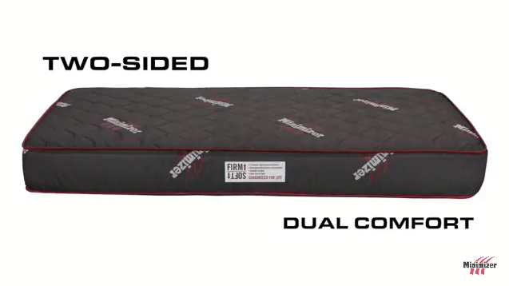

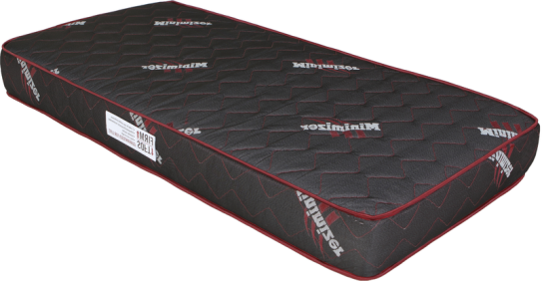

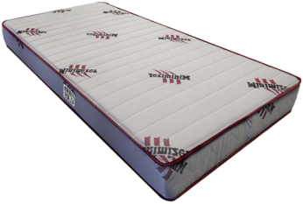


Minimizer Long Haul Series Mattress Video
Doctor Recommended Semi Truck Mattress Video

Slide 4

Drivers Love The Minimizer Long Haul Series Mattress Video

Slide 5
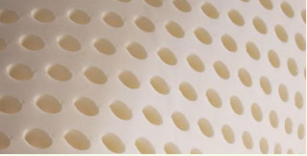
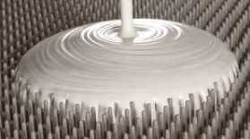
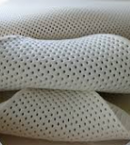
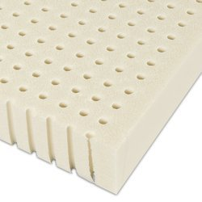
Why Mattresses?
  The same reason we are providing Seats! We Respect the Driver! It’s designed with the driver’s health and safety in mind. It incorporates the best materials available to provide whole body health in one “system” that provides features requested by professional drivers, and more. The Minimizer™ Long Haul Series Mattress System meets the physical and desired demands that are inherent to operating big trucks. This system provides the comfort, support, physical rejuvenation and durability your body requires and demands.
  The Long Haul Series Mattress System provides the driver with a mattress that improves their sleeping experience and improves their performance with refreshed wellbeing and alertness. The Long Haul Series Mattress System delivers the same results with a Guaranteed For Life Warranty.
  The key is the material used to build the mattress and how it is assembled to provide a driver with mattress options they wish they had at home. 100% Natural Organic Latex is the key.

Slide 6

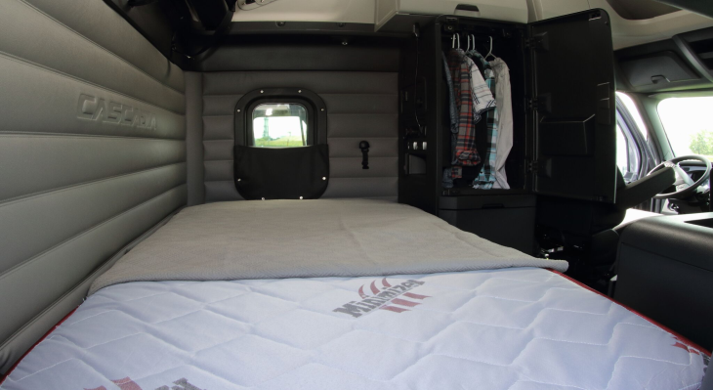
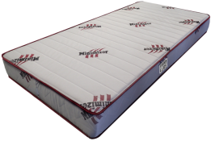


Slide 7

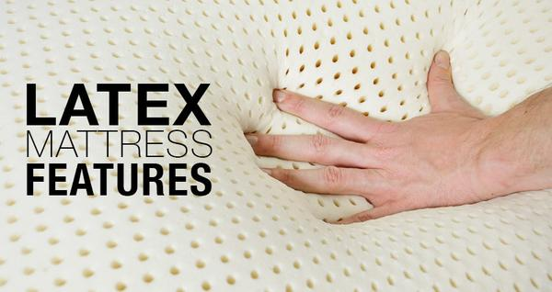

Slide 8
Product Offering
  SKU’s Dimensions Weight Estimated Sales Mix
    103015 32” W x 79” L x 10” H 51 lbs. / 23.13 kg. 6%
    103016 36” W x 80” L x 10” H 58 lbs. / 26.63 kg. 24%
    103017 39” W x 80” L x 10” H 63 lbs. / 28.58 kg. 37%
    103018 42” W x 80” L x 10” H 68 lbs. / 30.84 kg. 33%

Slide 9
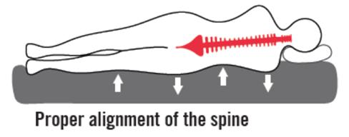

Slide 10
The superior qualities of an all latex mattress:
  Latex mattresses conform perfectly to your body’s contours and evenly supports the spine to provide optimal orthopedic support.
  Latex instantly reacts and adjusts to changes in position giving the body maximum comfort and back support. Its unique ability to conform to your body alleviates areas of high pressure that causes you to toss and turn at night.
  Latex is also hypoallergenic, anti-microbial, dust mite resistant, and breathable due to its open cell construction. Because it breathes to remove body moisture, it keeps you warm in the winter and cooler in the summer.
Superior Pressure Equalization:
  Latex relieves pressure that causes you to toss and turn at night. The ability of latex to gently support and conform to your body can alleviate pressure points and dramatically reduce tossing and turning. The latex mattress itself reduces pressure areas by as much as 90%, thus ensuring a sound and comfortable sleep.
Hypo-allergenic:
  Bacteria and mildew cannot live in latex. Latex is naturally hypoallergenic. Its ant-microbial properties inhibit dust mites, mold, and mildew from thriving. Because latex is a product of pin core construction with thousands of tiny air channels that provide natural ventilation. Mildew, staphylococcus and other bacteria can’t live in latex foam, making it the perfect choice for allergy sufferers and anyone wanting to breath, fresh clean air while they sleep.
  Independent tests prove latex can be up to 3x more resistant to dust mites than ordinary mattresses.

Slide 11
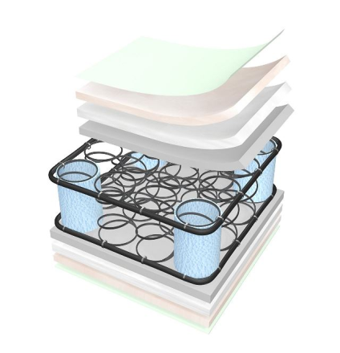
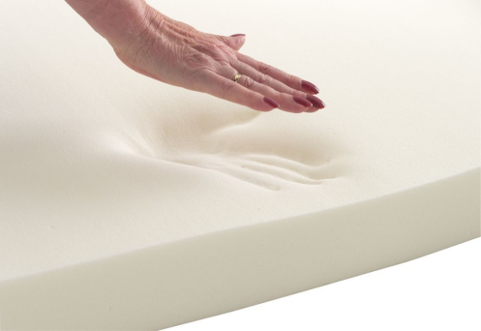

The most common mattresses are innerspring with foam; to make them more comfortable a layer of memory foam is added. Memory Foam has been the most recent beds to gain popularity both in at home sleeping beds and truck beds.
  Most users complain that they are hot and that they develop detents in the foam that makes it hard to roll over or climb out of bed. Some find it disruptive to their sleep during sleeping movements, due to the effort to get out of the molded area.
  They are available in varying thicknesses from as thin as 4” (min. required by FMVSS) to 10”
  The foam is dense (memory foam); you push your hand into it and it takes a few minutes for it to bounce back.
  Because the foam is dense and it encompasses you, many find them to be very warm.
What Minimizer has done is research what the needs are for every type of sleeping position and the weight span that exists between all driver sizes. As a result, the Minimizer mattress is rated to perform for drivers at 100 lbs. to 400 lbs. Other foam and memory foam mattresses either don’t rate them or the highest we found was 285 lbs.

Slide 12
Construction
Damask Ticking
FMVSS compliant
material
  Designed with two comfort options:
  Firm Side (Sleeping on Back)– 30 ILD
  Soft Side (Sleeping on Side) – 20 ILD
40 ILD Latex Center Core
Firm & Soft
Directional
Labels (2 sides)
ILD = Indentation Load Deflection is a measure or
firmness. The higher the number, the firmer
the mattress.

Slide 14
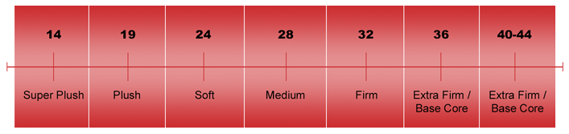

1/3 of your life-time is spent sleeping!
  Sleepers will be in one of three positions at anytime during a sleep cycle – that is the norm
  Back pain suffers usually select medium firm. People that like a buoyant, soft surface
  may be most happy with the soft side; most often a side sleeper.
  Minimizer has designed a mattress with 100% Natural Organic Latex, that creates the best mattress for every type of sleeper. Start with the firm side and go softer if needed.
Side Sleeper
Stomach Sleeper
20
30
40
Back Sleepers
Pressure Relief Cores Only

Slide 15



Slide 16



Slide 17
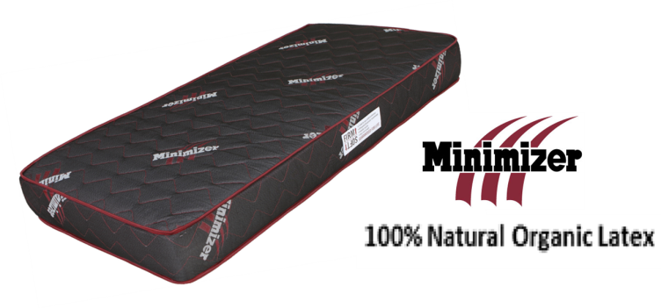
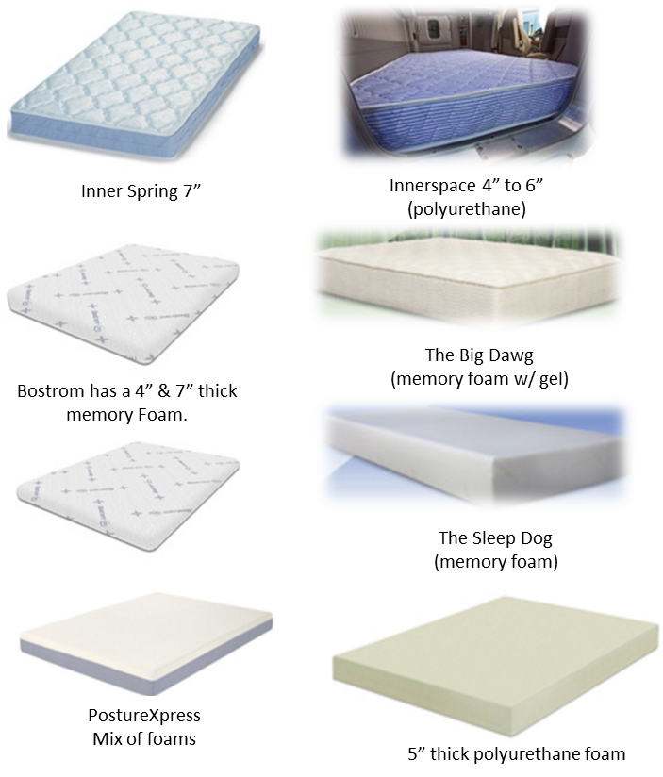
Consolidated competitive comparison summary
PosturXpress innerspring has a
memory foam with cool action gel.
Many manufacturers are reacting
to the complaint of hot mattresses by
adding gel or a layer of latex.
Latex mattresses available in the
consumer domestic market range from
$2,000 to $3,000 dollars
The only mattress that is

Slide 18
