Slide 1
Tool Caddy

Slide 2
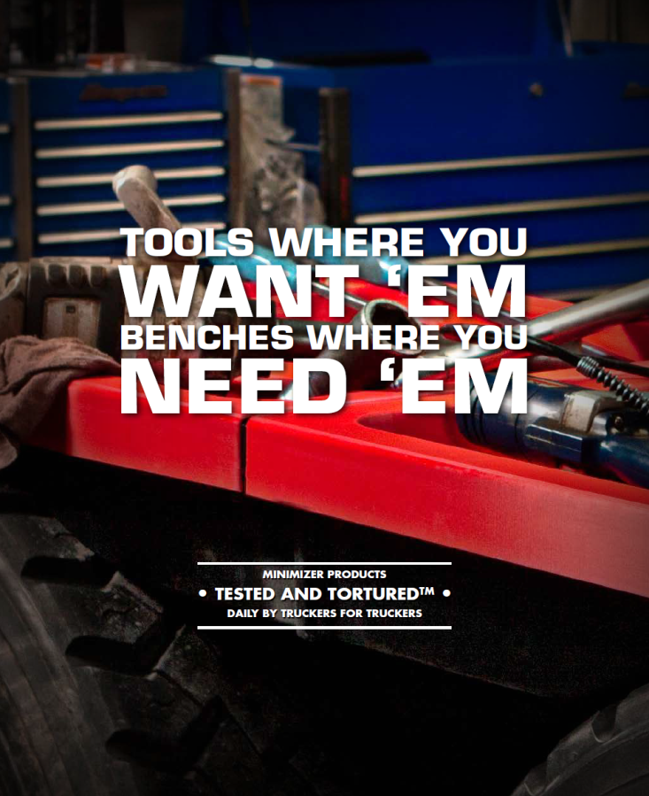
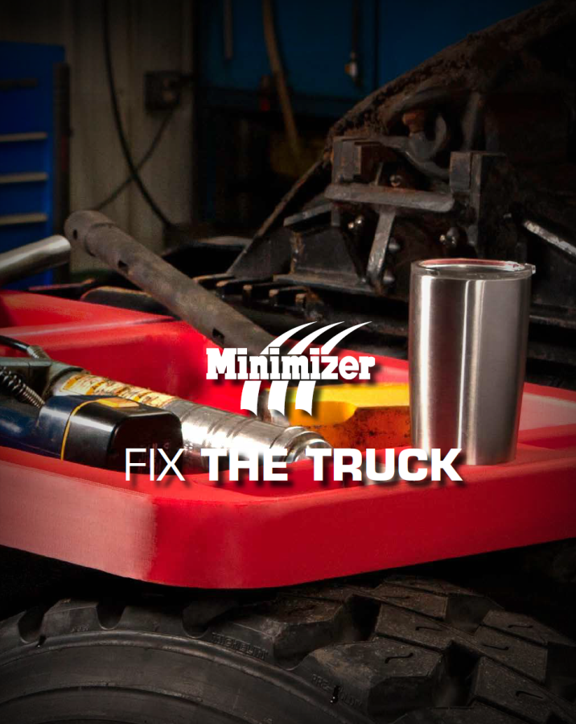

Slide 3
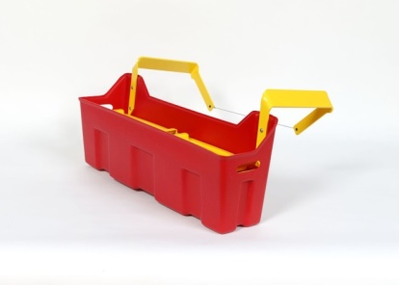
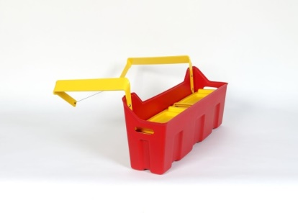
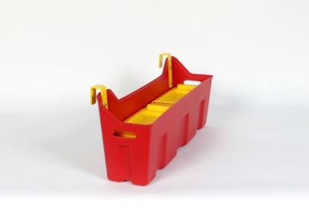

Slide 4
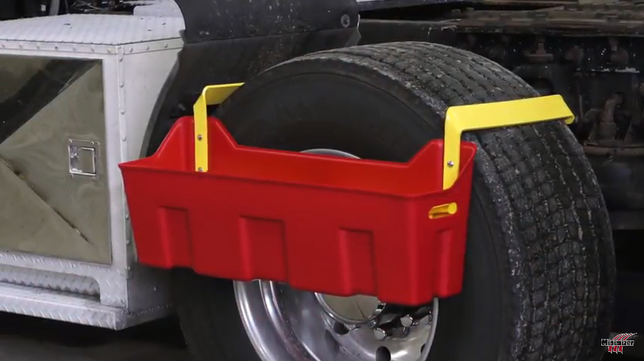
Tool Caddies

Slide 5
Fits Truck OEM Make & Models
Fits most make and model OEM trucks / trailers. Fits a wide range of tire sizes. Will work on Tandem Axles, Single Axles or multiple axle trucks, also will work on most flatbed trailers.
Warranty
Life-Time Warranty.
Features
Tool caddy molded as a singular piece
Three unique hanging arm sizes designed to fit most tires
Removable top trays
Minimizer does not recommend using as a step
Tools where you want em’, storage where you need em’..
100 lbs. Hanging Weight Capacity

Slide 6
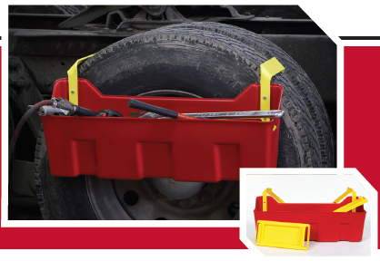

Slide 7
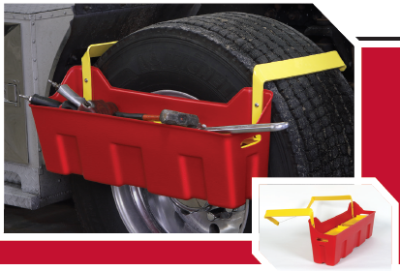

Slide 8
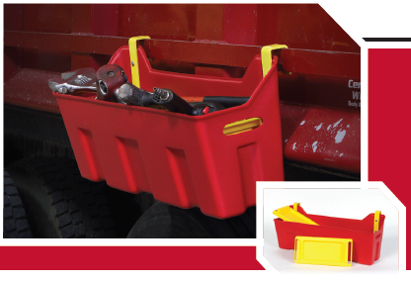

Slide 9
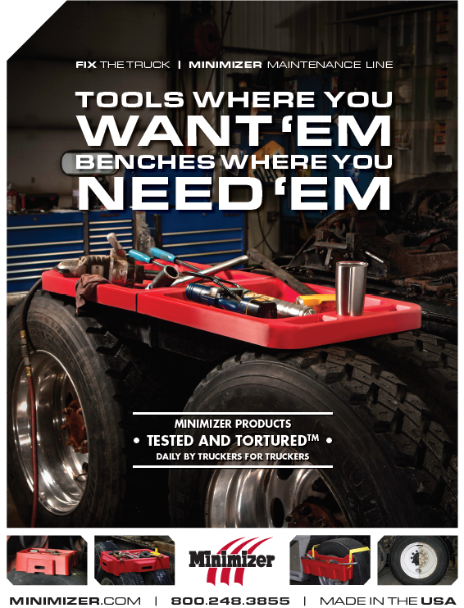

Slide 10
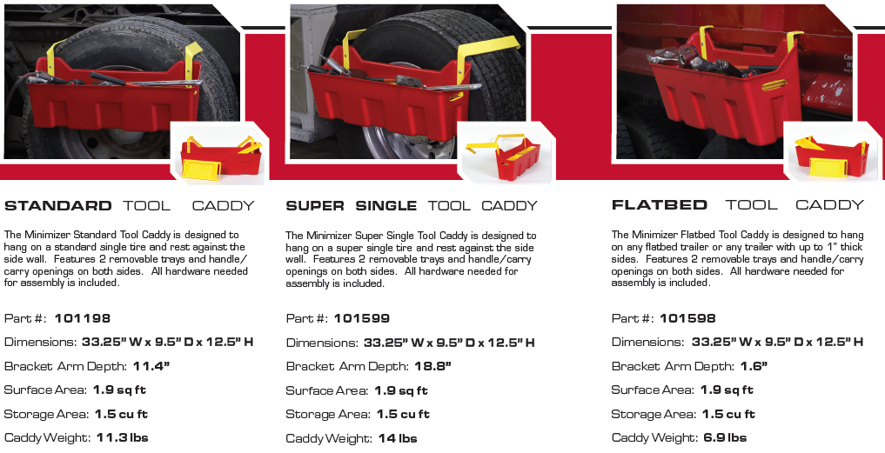
Hanging Tool Caddy

Slide 11
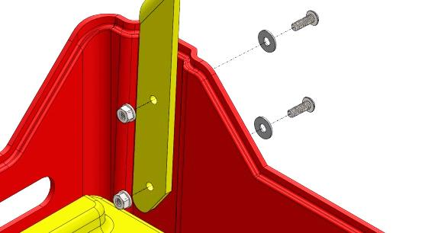
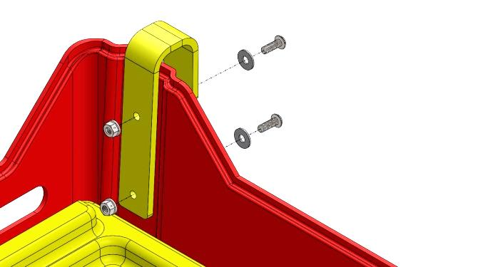
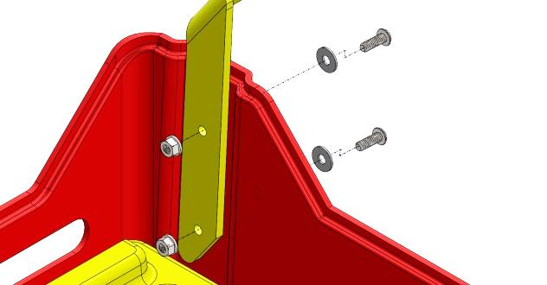
Tool Caddy
Installation Instructions
Mount YELLOW arm on left hand side of RED Caddy (I25C75MXTS head must be on tire side, so the end of the bolt does not scratch the tire). Shown in photo. Mounting hardware must be placed in this direction.
Mount YELLOW arm on right hand side of RED Caddy(I25C75MXTS head must be on tire side, so the end of the bolt does not scratch the tire). Shown in photo. Mounting hardware must be placed in this direction.
Place Lanyard in rear single mounting hole on SUPER SINGLE YELLOW ARMS shown in figure. Mounting hardware must be in the reverse orientation as mounting arm to tool caddy. **LANYARD ONLY SUPPLIED WITH SUPER SINGLE TOOL CADDY**

Slide 12
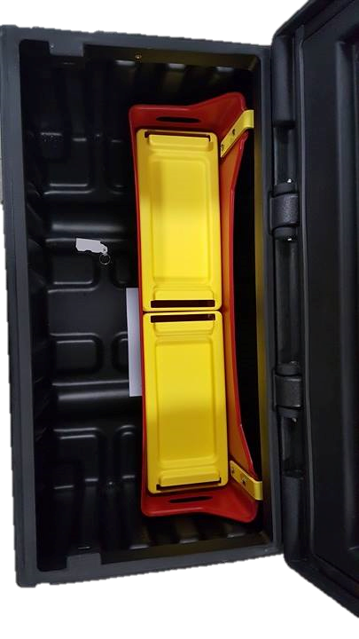
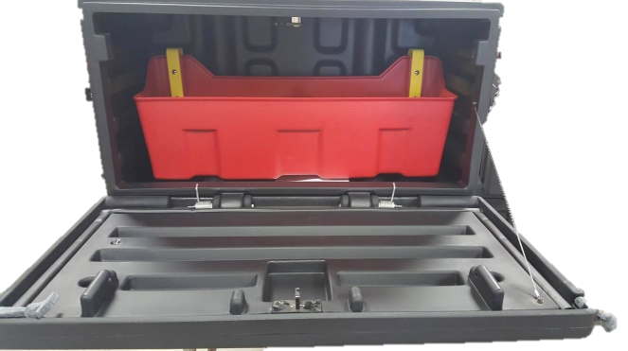
Tool Caddy Flat Bed Part# 101598 will work with MINIMIZER 36in. Chest or Underbody Boxes.

