Slide 1


T
Super Single Fenders

Slide 2
T

Slide 3
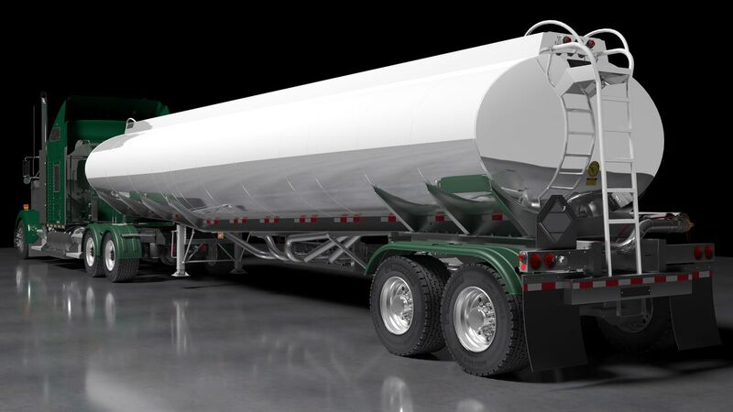
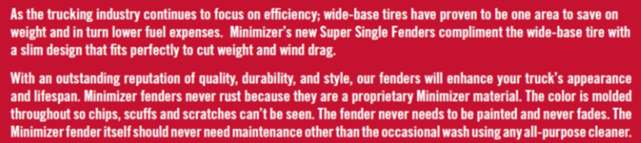
T

Slide 4
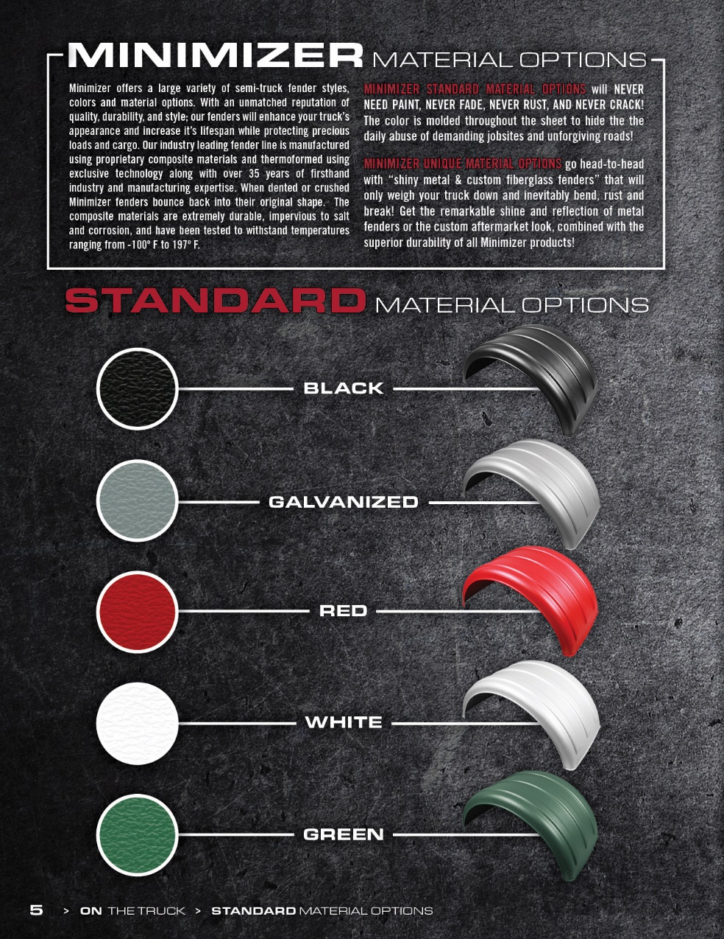
T

Slide 5
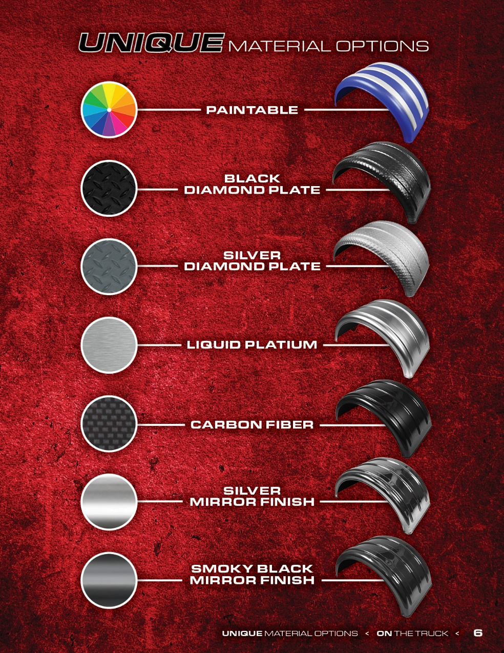
T

Slide 6

T

Slide 7
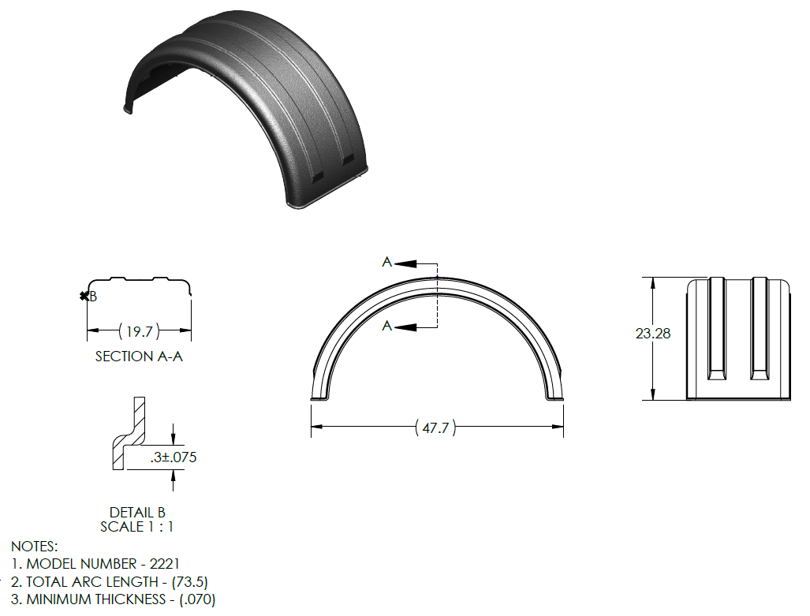
T
Super Single Fenders – Model 2220
Profile similar to a PM2218
(Except 4” deeper and 1.5” longer)
Weight: 7.2 lbs. / 3.27 kg.

Slide 8
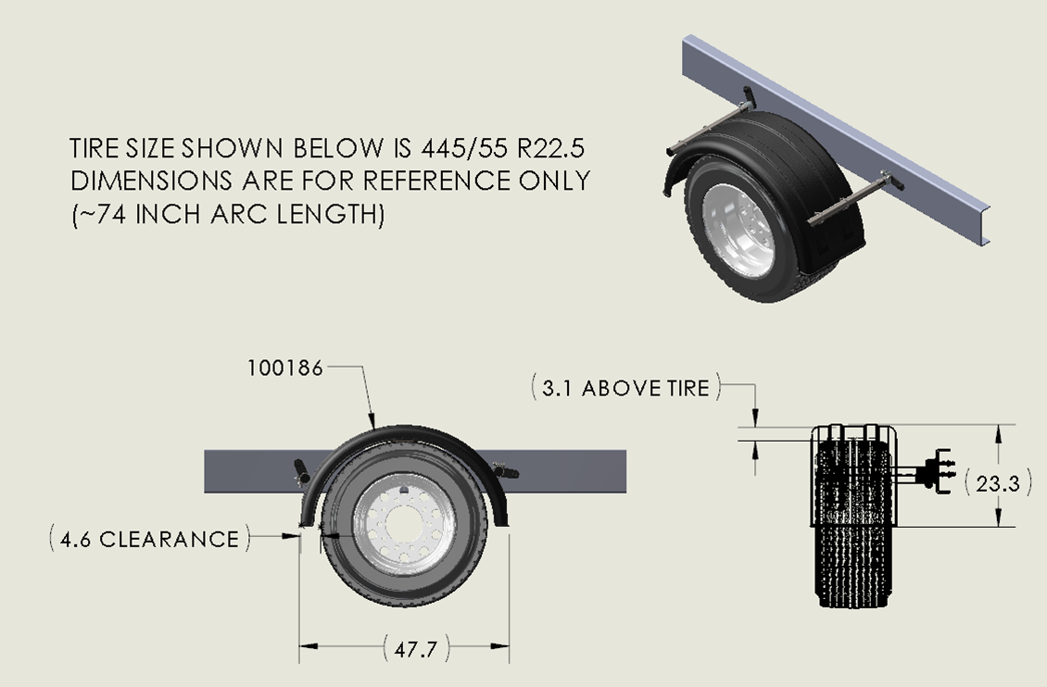
T
Super Single Fenders – Model 2220 Fitment Detail

Slide 9
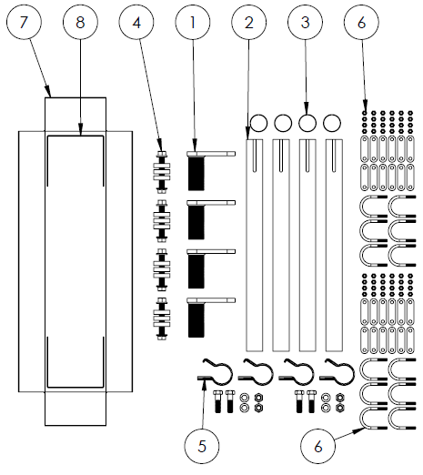
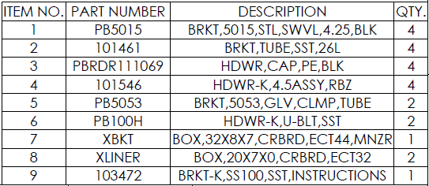
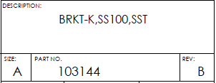

T
Super Single Bracket Kits – Single Axle Fenders
Weight: 30 lbs. / 13.61 kg.

Slide 10
T
Part Number Conversion

Slide 11

T

Slide 12
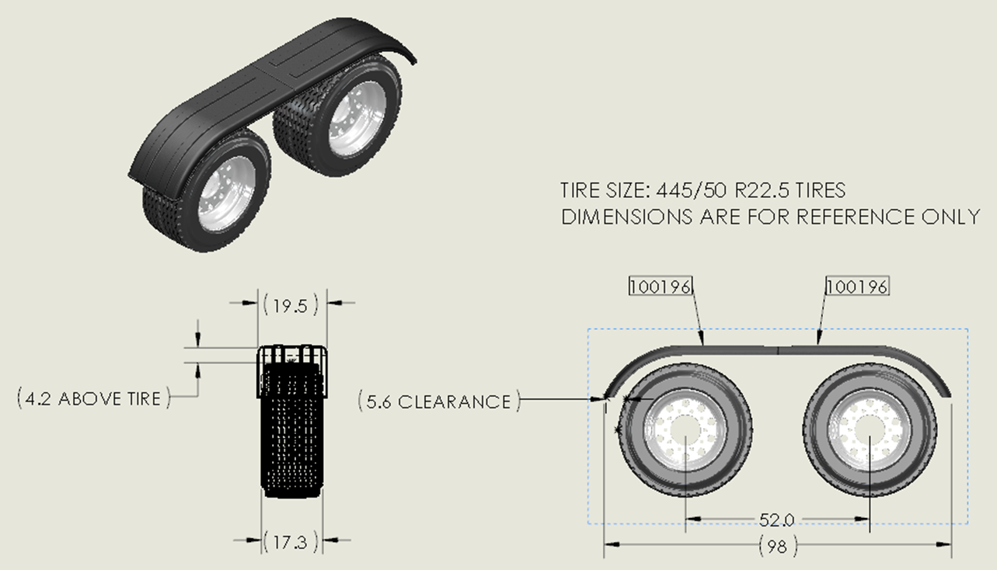
T
Super Single Fenders – Model 4020 Fitment Detail
FIT ON 52 INCH AXLE SPREAD

Slide 13
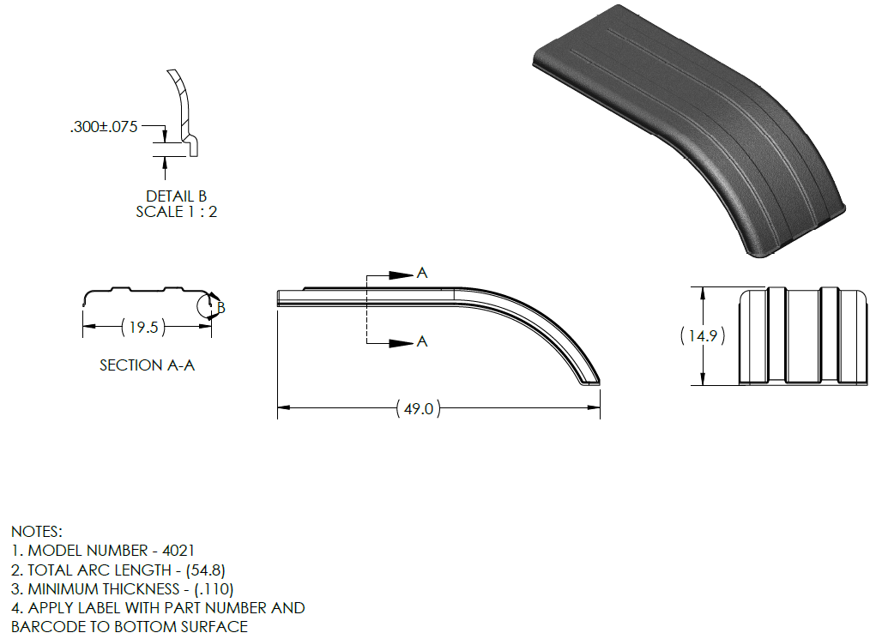
T
Super Single Fenders – Model 4020
(Profile similar to PM4001)
Weight: 7.2 lbs. / 3.27 kg.

Slide 14
T
Part Number Conversion

Slide 15
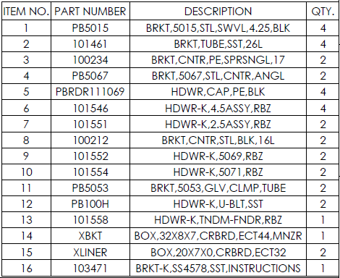
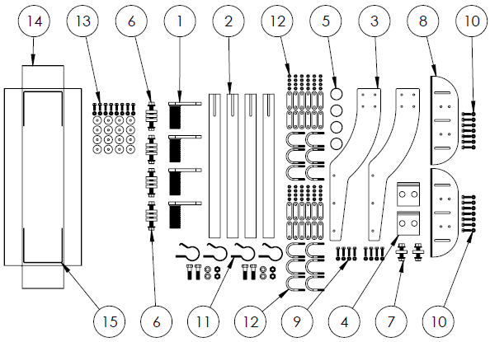
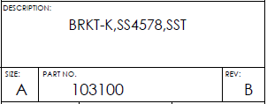

T
Super Single Bracket Kits – Tandem Axle Fenders
Weight: 42 lbs. / 19.05 kg.

Slide 16

T

Slide 17
T
Super Single Fenders – Model 4070
(Profile similar to PM4001)
Weight: 7.2 lbs. / 3.27 kg.

Slide 18
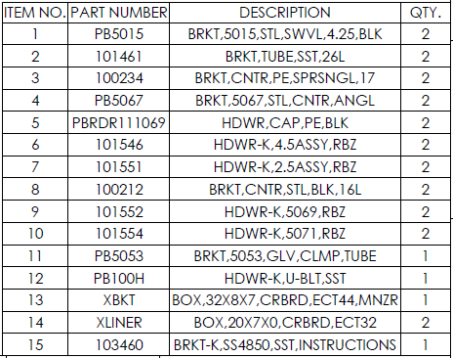
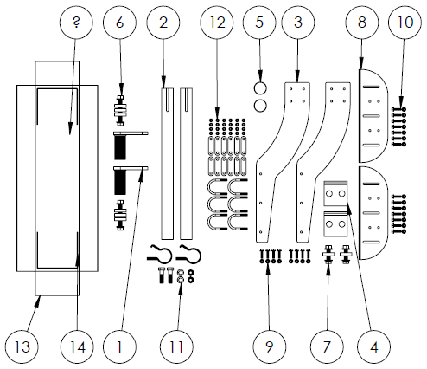
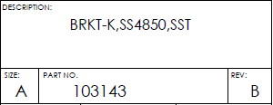

T
Super Single Bracket Kits – Half Tandem Fenders
Weight: 27 lbs. / 12.25 kg.

Slide 19
T
Part Number Conversion

Slide 20

T

Slide 21
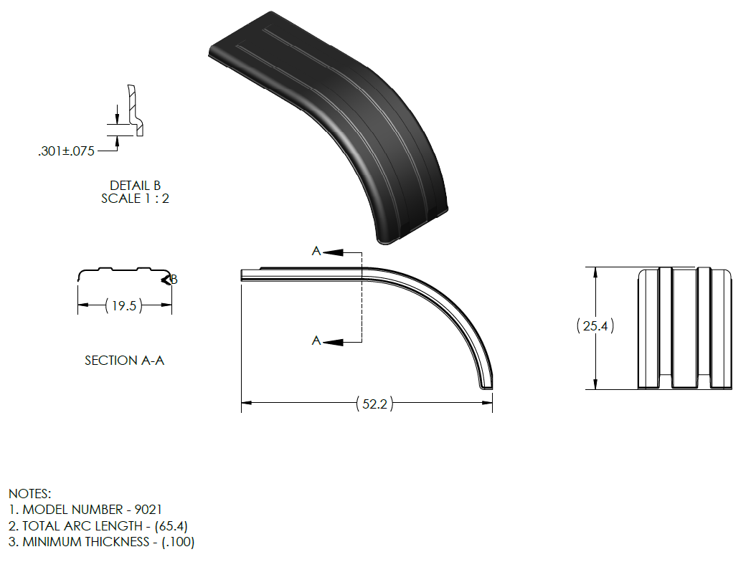
T
Super Single Fenders – Model 9020
(Profile similar to PM901)
Note: Not available in GRN
Weight: 10.0 lbs. / 4.54 kg.

Slide 22
T
Super Single Bracket Kits – Tandem Axle Fenders
Weight: 42 lbs. / 19.05 kg.

Slide 23
T
Part Number Conversion

Slide 24
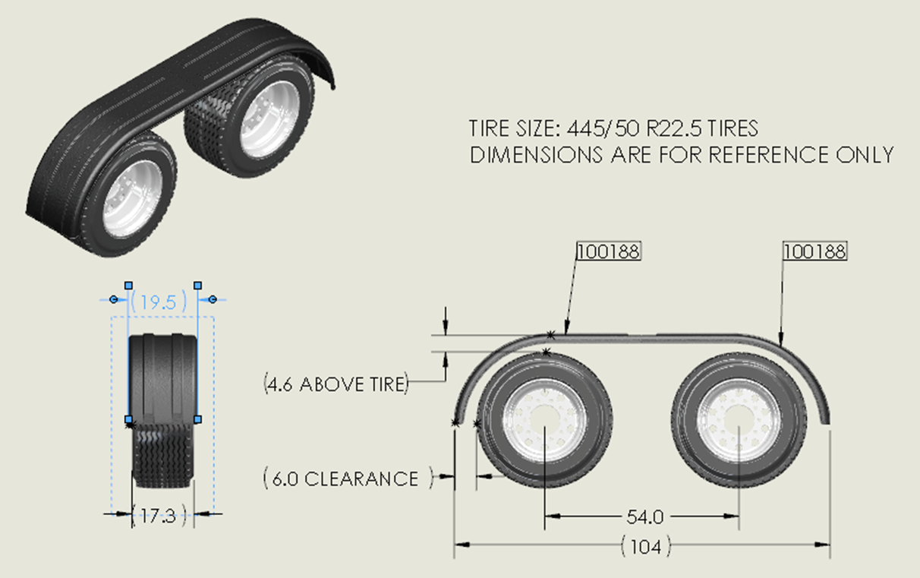
T
Super Single Fenders – Model 9020 Fitment Detail
FIT ON 54 INCH AXLE SPREAD

Slide 25

T

Slide 26
T
Super Single Fenders – Model 9070
(Profile similar to PM901)
Note: Not available in GRN
Weight: 10.0 lbs. / 4.54 kg.

Slide 27
T
Super Single Bracket Kits – Half Tandem Fenders
Weight: 27 lbs. / 12.25 kg.

Slide 28

T

Slide 29
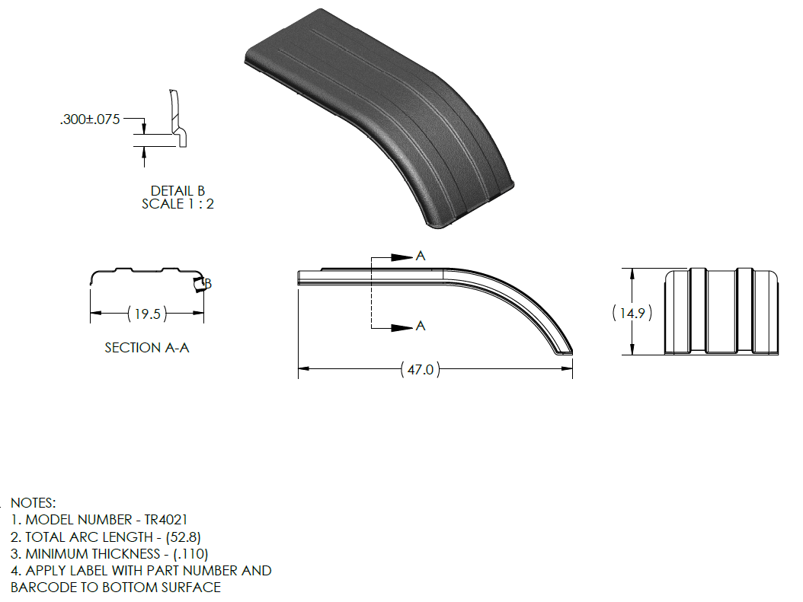
T
Super Single Fenders – Model TR4020
(Profile similar to PM4001)
Weight: 7.7 lbs. / 3.49 kg.

Slide 30
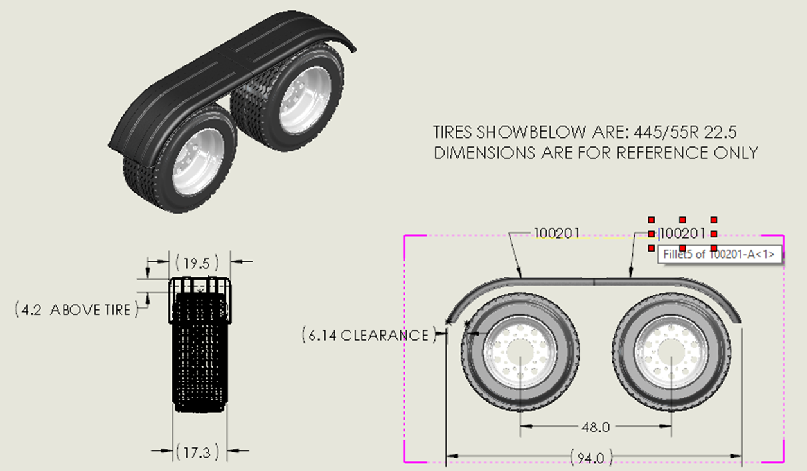
T
Super Single Fenders – Model TR4020 Fitment Detail
FIT ON 48 INCH AXLE SPREAD

Slide 31
T
Super Single Bracket Kits – Tandem Axle Fenders
Weight: 42 lbs. / 19.05 kg.

Slide 32
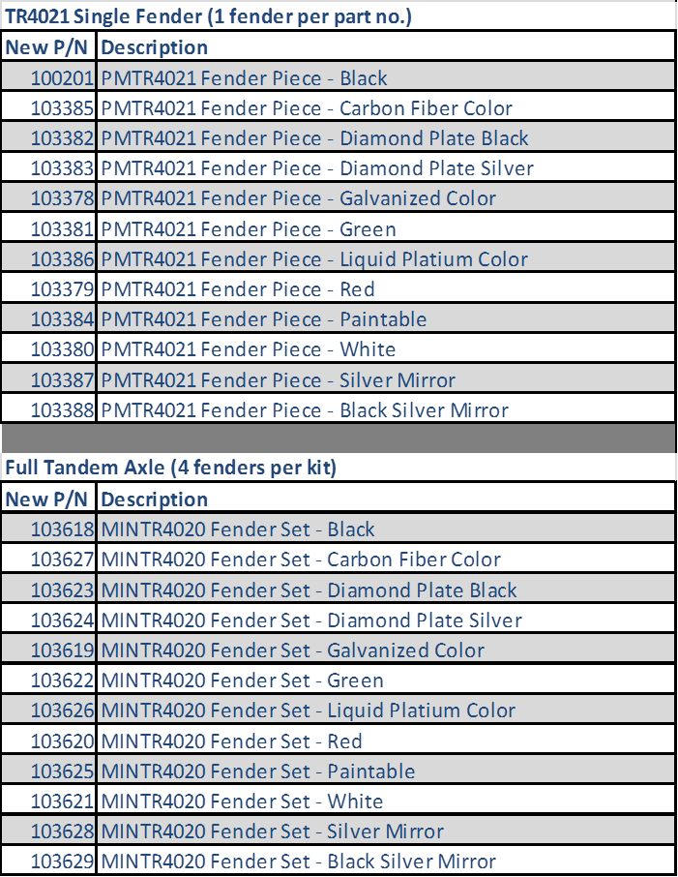
T
Part Number Conversion

Slide 33

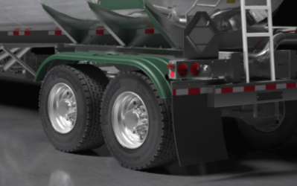
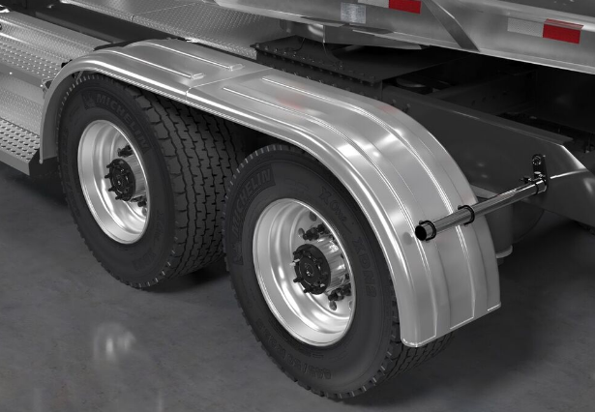
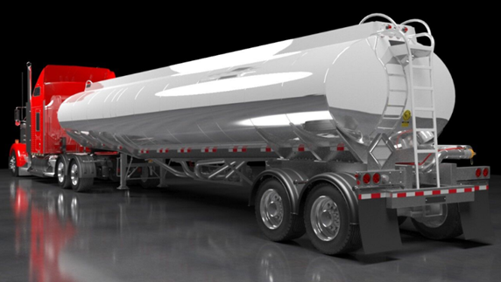
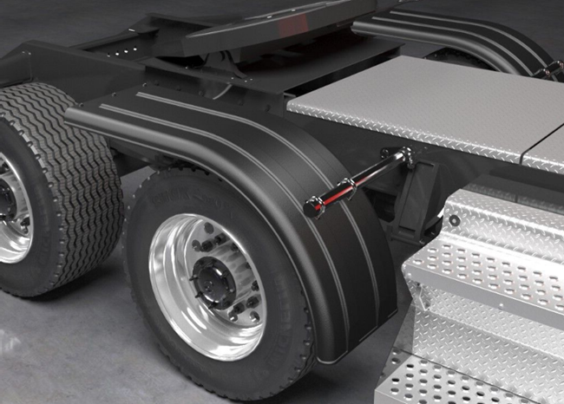
T

